Slide 1


Welcome you all
MySQL
Day 4
D.Sakthivel
Assistant Professor & Trainer,
KGiSL Micro College
KGiSL Campus, Coimbatore – 641 035.

Slide 2
Day 4
SUB QUERIES
TRANSACTIONS
ROLLBACK
COMMIT
ACID PROPERTY
VIEWS

Slide 3
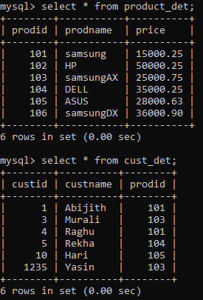
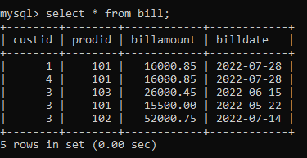
SUB QUERIES

Slide 4
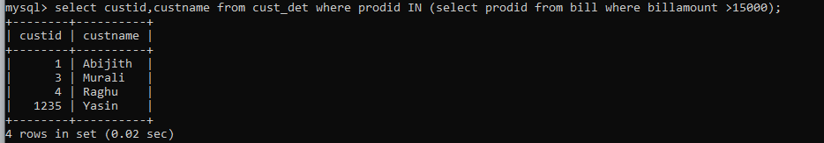
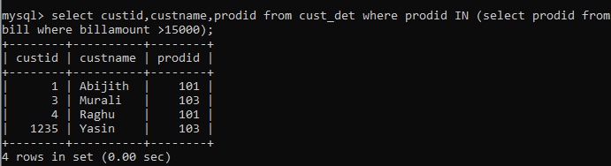
SUB QUERIES
TO FIND CUSTOMER WHOSE BILL AMOUNT > 15000( COMBINE TWO TABLES)

Slide 5
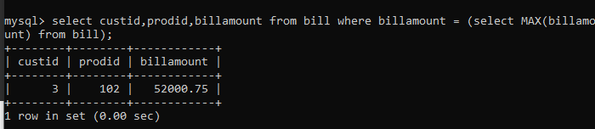
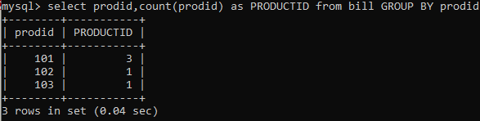
SUB QUERIES
TO FIND CUSTOMER OF MAXIMUM BILL AMOUNT .
MySQL correlated subquery

Slide 6
TRANSACTIONS
Transactions are units or sequences of work accomplished in a logical order, whether in a manual fashion by a user or automatically by some sort of a database program.
A database transaction is the propagation of one or more changes as a single action on the database.
The COMMIT statement saves all the modifications made in the current.
The ROLLBACK operation undoes all the changes done by the current transaction i.e. If you invoke this statement, all the modifications are reverted until the last commit or the START TRANSACTION statement.

Slide 7
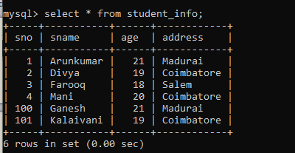
TRANSACTIONS
The ROLLBACK operation undoes all the changes done by the current transaction i.e. If you invoke this statement, all the modifications are reverted until the last commit or the START TRANSACTION statement.
Before Rollback:

Slide 8
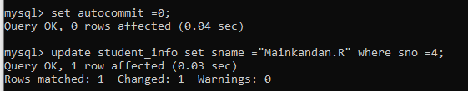
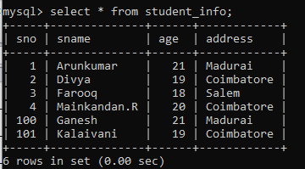
ROLLBACK operation
Update operation:
:

Slide 9
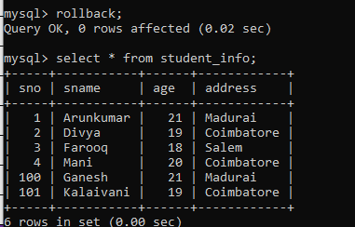
ROLLBACK operation
Rollback operation:

Slide 10
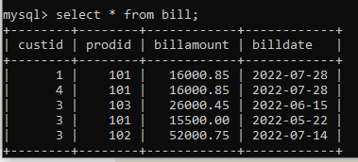
ROLLBACK operation
After Rollback operation:
The update cannot be reflect on the database after rollback – (it restore the previous data)

Slide 11
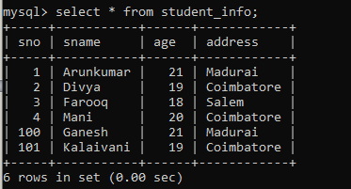
The COMMIT statement saves all the modifications made in the current.
BEFORE COMMIT:

Slide 12



COMMIT operation
Update operation:
COMMIT OPERATION:
Rollback operation:

Slide 13
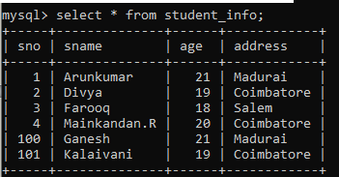
COMMIT operation
After Commit and Rollback operation:

Slide 14
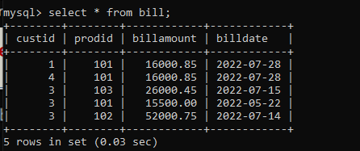
COMMIT operation
After COMMIT & Rollback operation :
The data cannot be changed once committed and never rollback the previous data

Slide 15
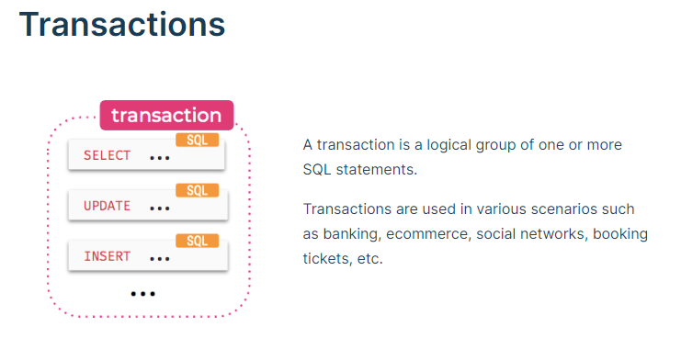
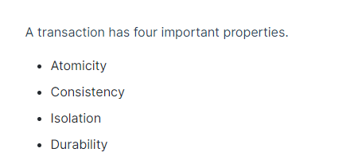

Slide 16
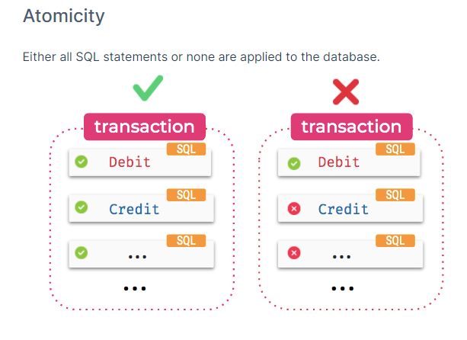

Slide 17
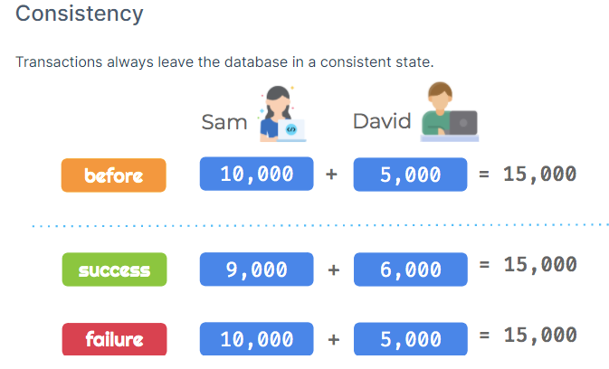

Slide 18
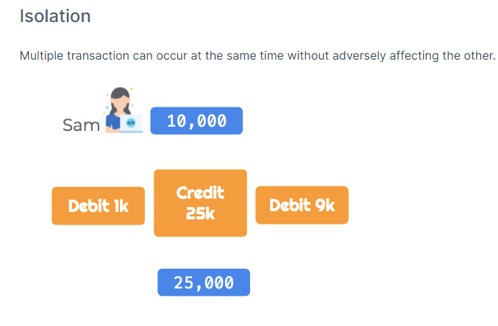

Slide 19
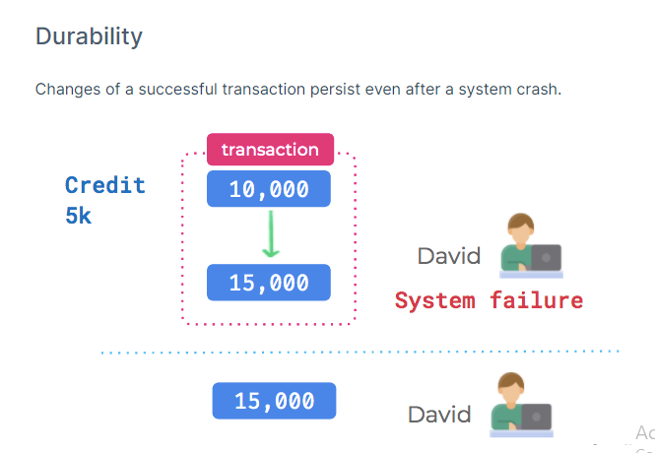
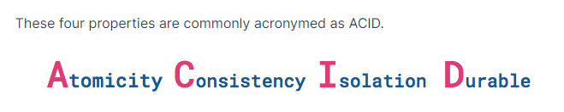

Slide 20
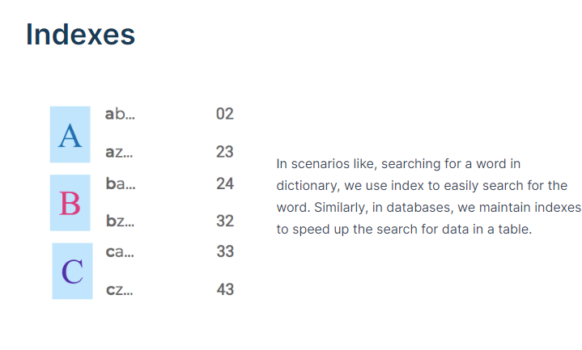

Slide 21
VIEWS
A view is a database object that has no values. Its contents are based on the base table. It contains rows and columns similar to the real table.
In MySQL, the View is a virtual table created by a query by joining one or more tables.
It is operated similarly to the base table but does not contain any data of its own.
The View and table have one main difference that the views are definitions built on top of other tables (or views).
If any changes occur in the underlying table, the same changes reflected in the View also.

Slide 22
VIEWS
A view is a database object that has no values. Its contents are based on the base table. It contains rows and columns similar to the real table.
In MySQL, the View is a virtual table created by a query by joining one or more tables.
It is operated similarly to the base table but does not contain any data of its own.
The View and table have one main difference that the views are definitions built on top of other tables (or views).
If any changes occur in the underlying table, the same changes reflected in the View also.
You can use views to hide table columns from users by granting them access to the view and not to the table itself.

Slide 23
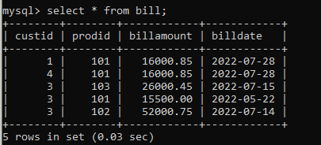

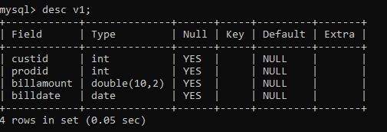
CREATE VIEW:
TABLE:
VIEW CREATION:

Slide 24
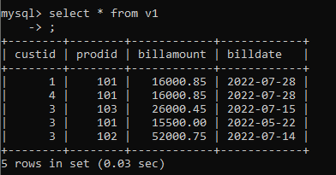
SELECT QUERY USING VIEW:

Slide 25
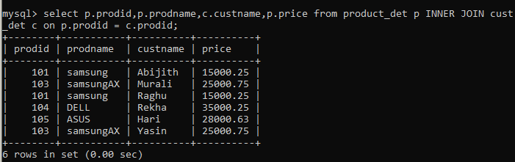
CREATE VIEW FOR JOINS:
JOIN TABLE:
VIEW CREATION:

Slide 26
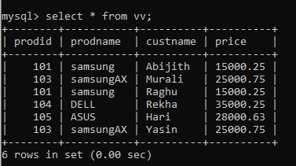
SELECT JOIN QUERY USING VIEW:

Slide 27

DROP VIEW:

Slide 28



Thank You

